Slide 1
Intro to ASP.NET Core
Mike Rousos
Principal Software Engineer
.NET Customer Engagement Team

Slide 2
ASP.NET Core
ASP.NET redesigned to be leaner and more modular
Lightweight, higher-performance and modular HTTP request pipeline
Cross-platform
Runs on .NET Core or .NET Framework runtimes
Open-source and community-focused
https://github.com/aspnet/home

Slide 3
Introductions
How many of you have tried ASP.NET Core already?
2.0 or previous versions?
How many of you are familiar with ASP.NET MVC?
How many of you are familiar with Docker?
What languages do you primarily develop in?
C#, VB, F#, Java, JavaScript, Ruby, Python, something else?

Slide 4
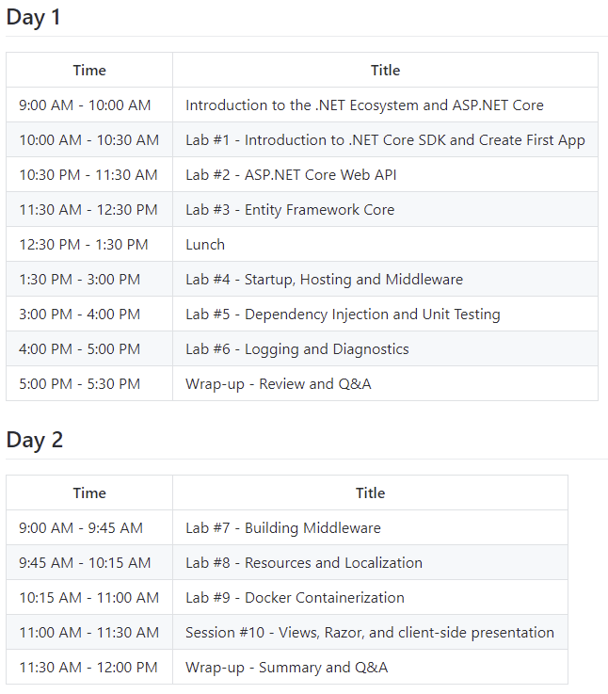
Workshop Resources
Lab Resources
Setup instructions, lab transcripts, agenda, and slides can be found at https://github.com/mjrousos/aspnetcore-workshop/
ASP.NET Core Documentation can be found at https://docs.asp.net

Slide 5
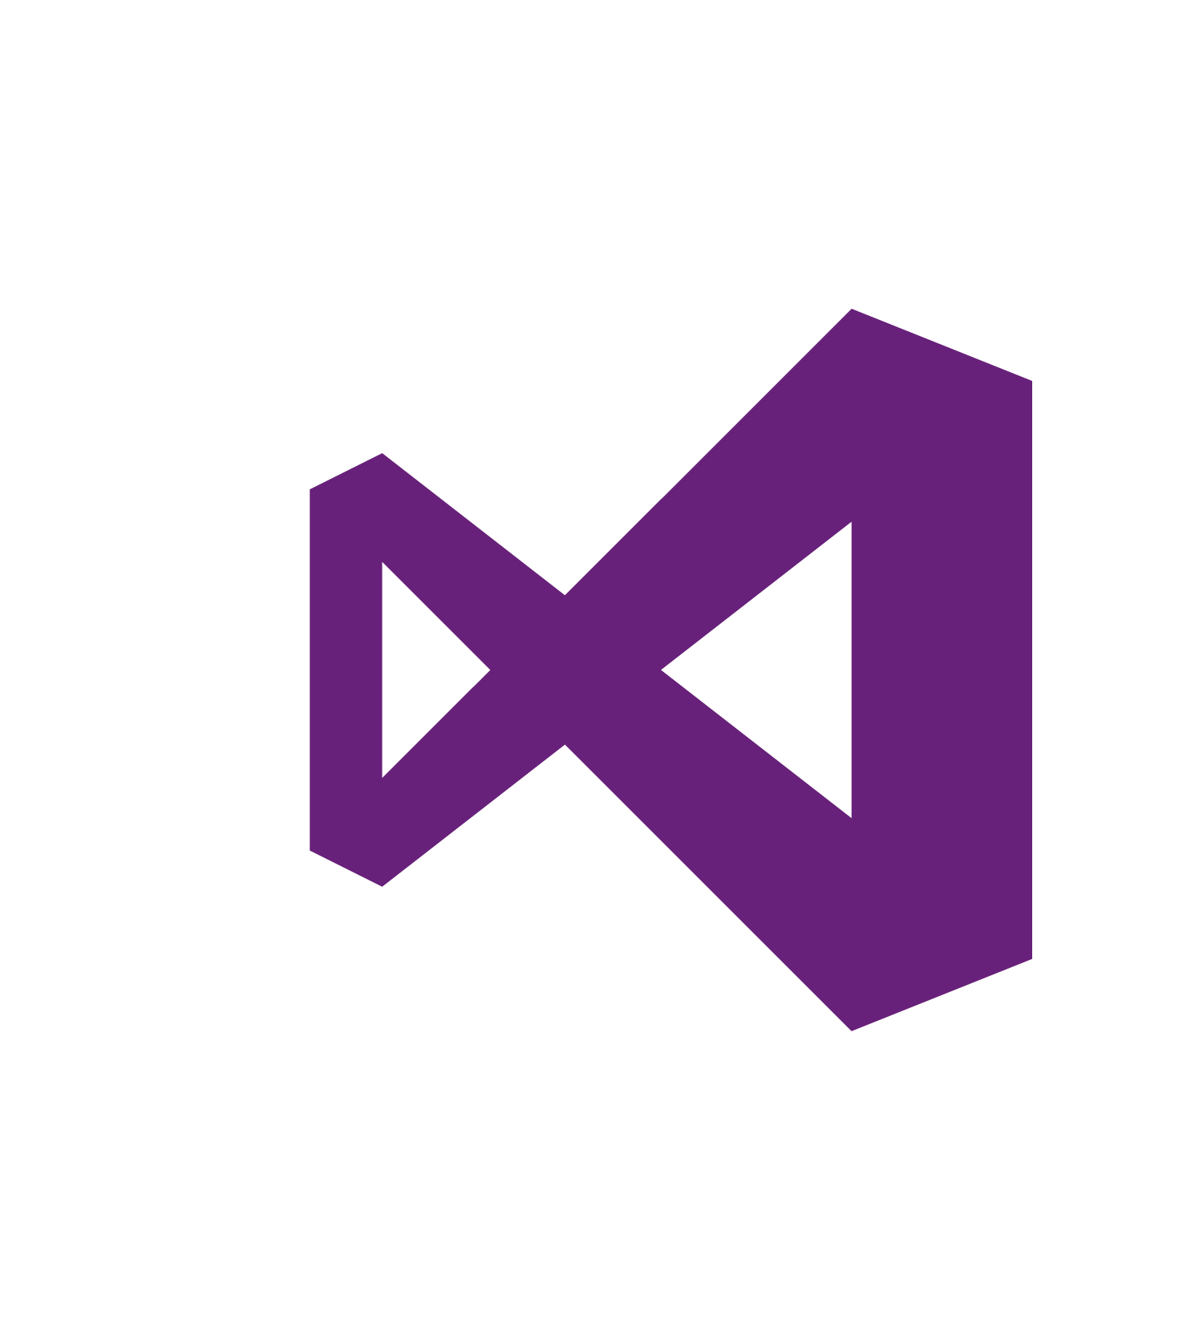
.NET platform
DESKTOP
.NET FRAMEWORK
WINDOWS UWP
.NET CORE
ASP.NET
MOBILE
CLOUD
XAMARIN
TOOLS
Visual Studio
.NET STANDARD LIBRARY
Visual Studio for Mac
COMMON INFRASTRUCTURE
Visual Studio Code
Compilers
Languages
Runtime components

Slide 6
.NET Core -- Cross-platform services
DESKTOP
.NET FRAMEWORK
WINDOWS UWP
.NET CORE
ASP.NET
MOBILE
CLOUD
XAMARIN
TOOLS
Visual Studio
.NET STANDARD LIBRARY
Visual Studio for Mac
COMMON INFRASTRUCTURE
Visual Studio Code
Compilers
Languages
Runtime components

Slide 7

.NET Core
Cross-platform
Windows, Linux and macOS

Slide 8

http://redhatloves.net

Slide 9
Supported OSes
Windows
Windows 7+
Server 2008 R2 SP1+
Server 2016 (incl. Nano)
macOS
Sierra
Linux
RHEL
Fedora
Centos
Debian
Ubuntu
Linux Mint
openSUSE
Oracle Linux

Slide 10

.NET Core
Cross-platform
Windows, Linux and macOS
Fast
ASP.NET Core on .NET Core is 4x faster than Node.js in TechEmpower benchmark

Slide 11
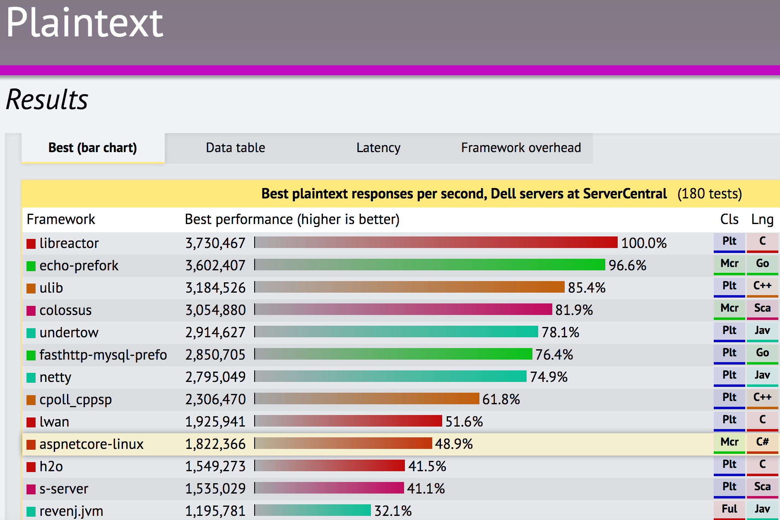
TechEmpower Framework Benchmarks – Round 13 – PlainText
https://techempower.com/benchmarks/

Slide 12

.NET Core
Cross-platform
Windows, Linux and macOS
Fast
ASP.NET Core on .NET Core is 4x faster than Node.js in TechEmpower benchmark
Lightweight
No impact deployment and a modular development model perfect for containers

Slide 13
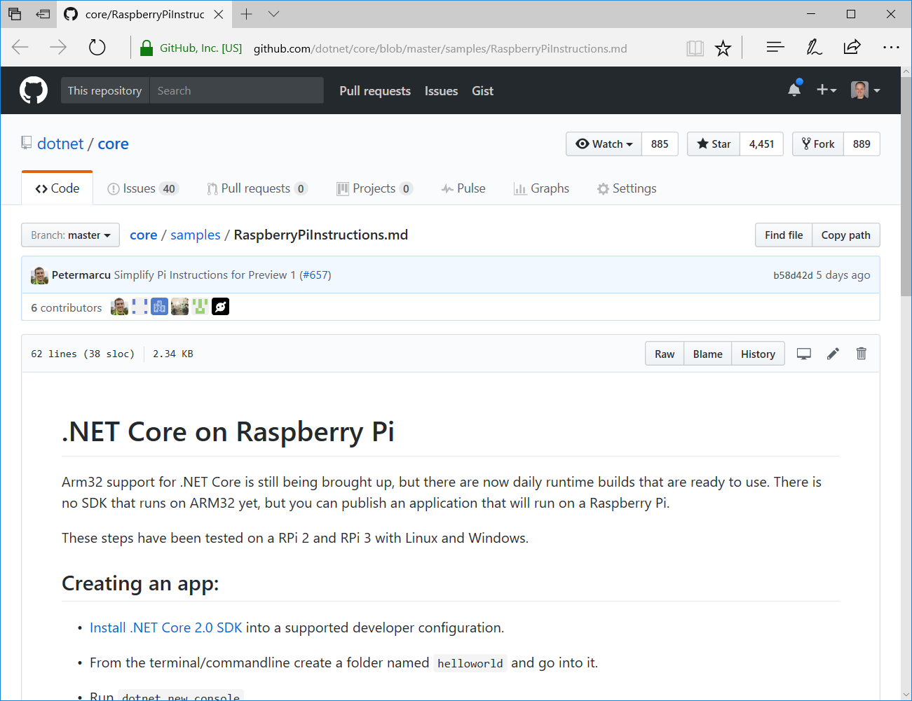
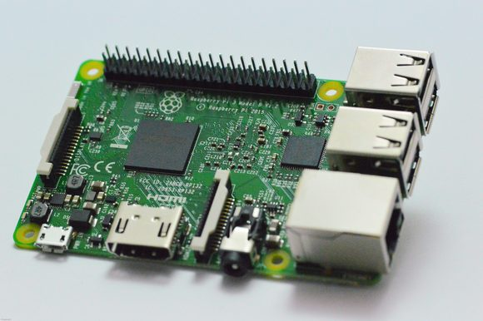

Slide 14
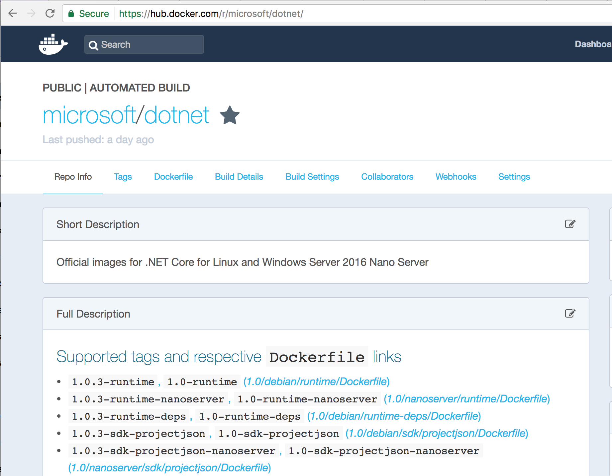

Slide 15

.NET Core
Cross-platform
Windows, Linux and macOS
Fast
ASP.NET Core on .NET Core is 4x faster than Node.js in TechEmpower benchmark
Lightweight
No impact deployment and a modular development model perfect for containers
Open source
Runtime, libraries, compiler, languages and tools developed in the open in GitHub

Slide 16

.NET Open Source Contributions as of 2016

Slide 17

Get .NET Core
Install the .NET Core SDK (https://dot.net)
Install Visual Studio (https://visualstudio.com)
Visual Studio
Windows
Visual Studio for Mac
macOS
Visual Studio Code
Windows, macOS, Linux

Slide 18
Getting Started with .NET Core
Notes:
dotnet new console
dotnet run
dotnet .dll
dotnet build

Slide 19
.NET Core Command Line Interface (CLI)
> dotnet new console // creates new project
> dotnet restore // restore NuGet dependencies
> dotnet build // builds your source into dlls
> dotnet path-to/yourapp.dll //loads and runs
> dotnet run // same thing as the last 2 lines
> dotnet add // add package or project references
> dotnet test // runs your tests;reports pass/fail
> dotnet publish // prepares app for distribution
> dotnet pack // packages library as NuGet package

Slide 20
ASP.NET Core
Fast & lightweight web framework built for .NET Core
Build modern web apps
MVC apps, Web APIs, SPAs, mobile apps, microservices, docker, real-time (future)
Integrates seamless with Azure cloud services
Azure App Services, SQL Azure, Azure Key Vault, Azure Application Insights, Azure Active Directory, etc.
Or run it on premise, on Google App Engine, on AWS, etc.
Powerful security features
HTTPS, identity, data protection, OpenID Connect, JWT, CORS, 2-factor auth, social logins
Simple composable infrastructure
Dependency injection, middleware, configuration, logging, localization, routing, session, error handling

